Slide 1
UArizona ASCEND: Profiling High-Altitude Radiation with a General Data Logger
University of Arizona ASCEND Launch Fall & Spring
Speakers:
Nicolas Blanchard, Sarina Blanchard, Arsh Nadkarni, Jaret Rickel, Paul O’Brien Sylvester, Grace Halferty, Isela Burruel, Michelle Burr

Slide 2
Agenda
Fall and Spring Launch & Payloads
Results and Conclusions

Slide 3
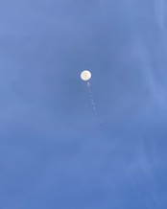
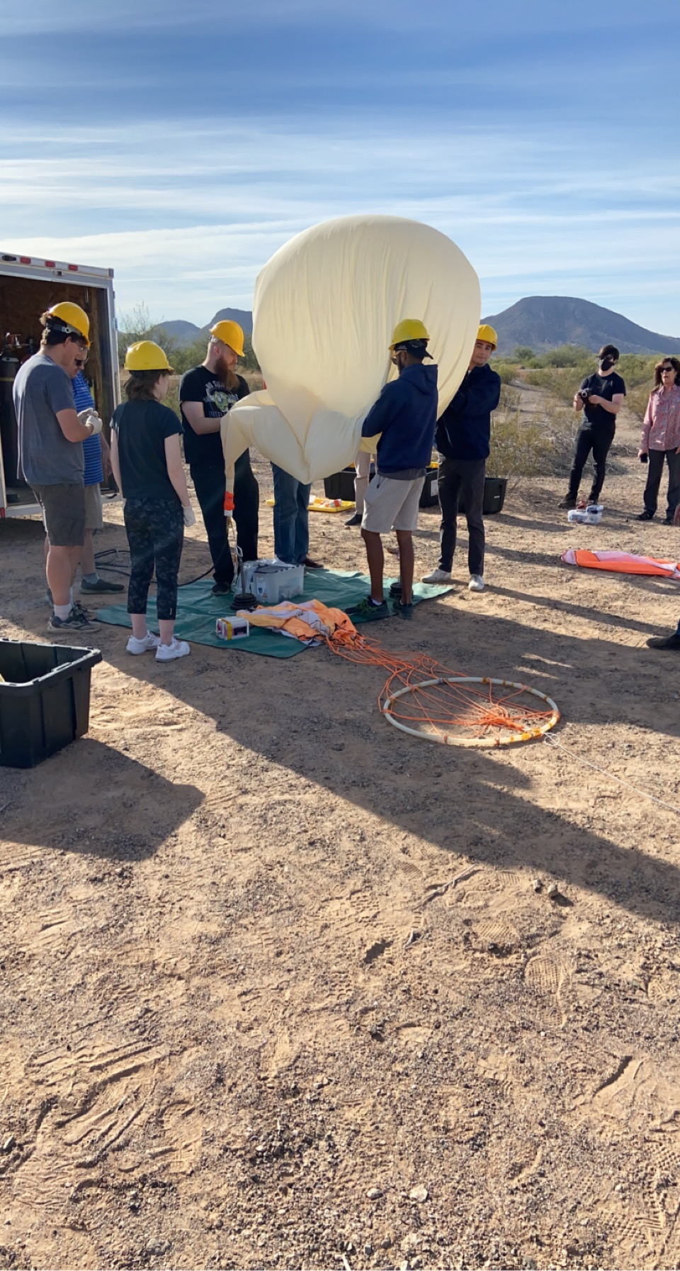
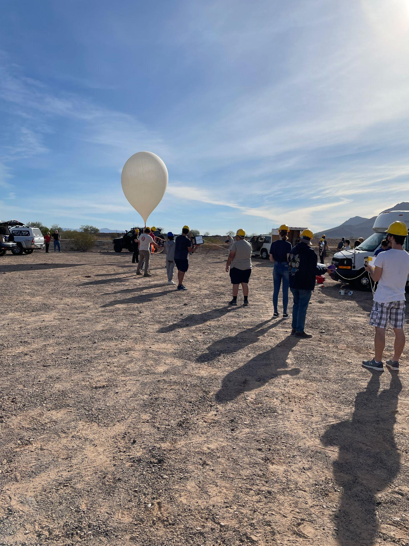
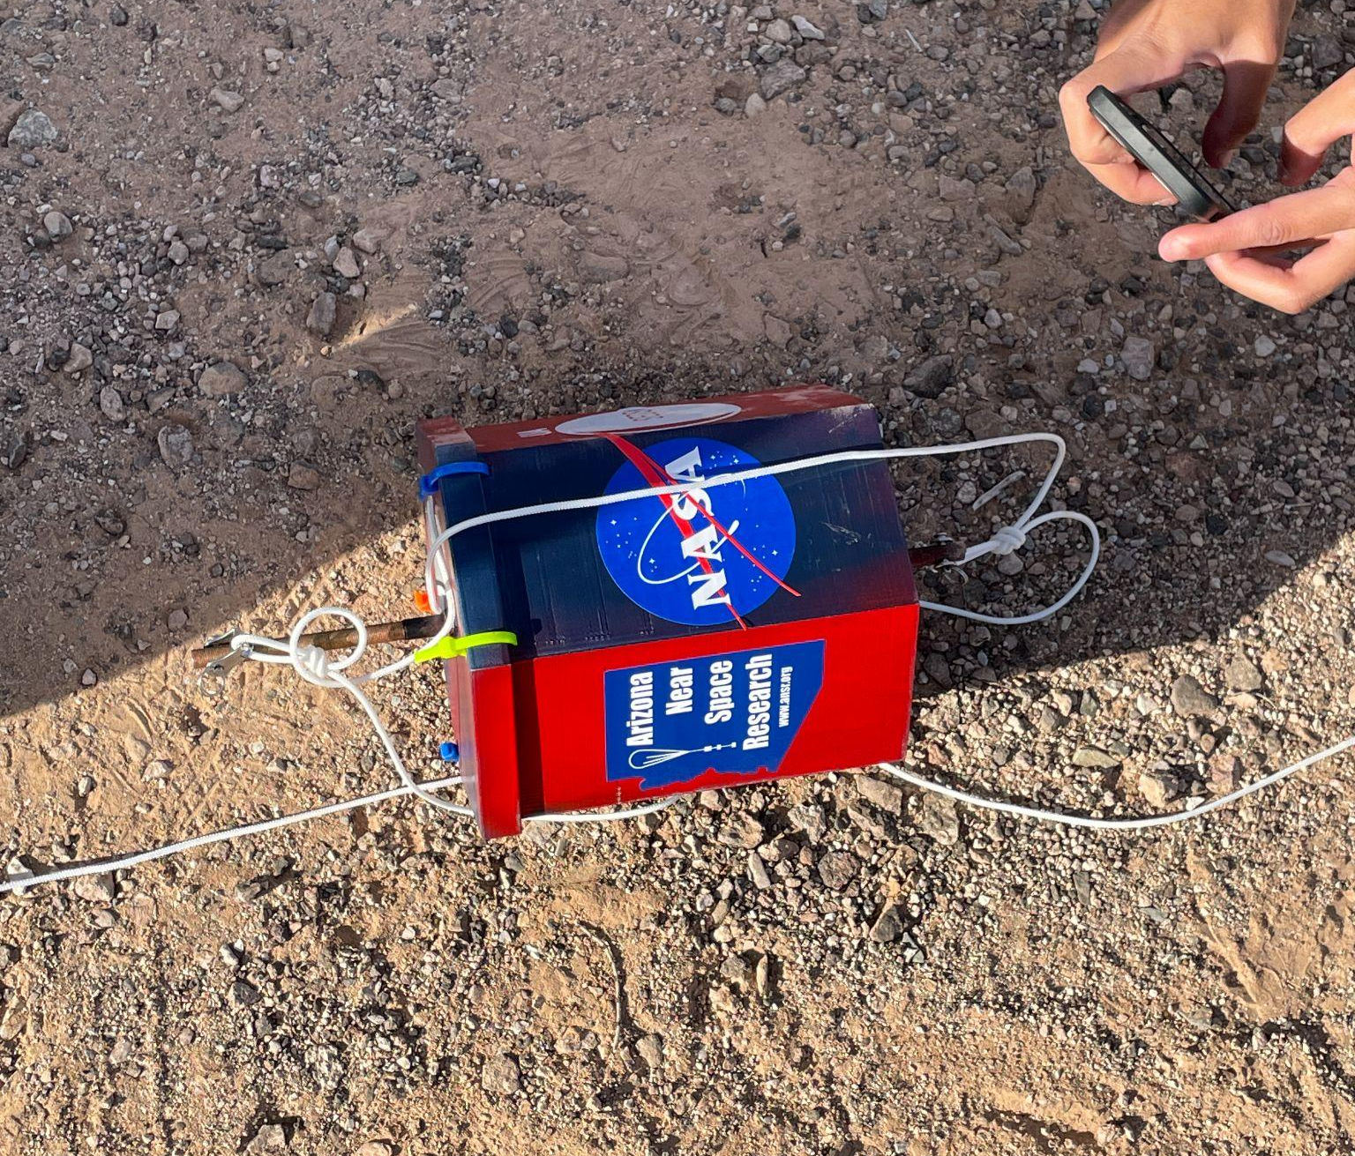
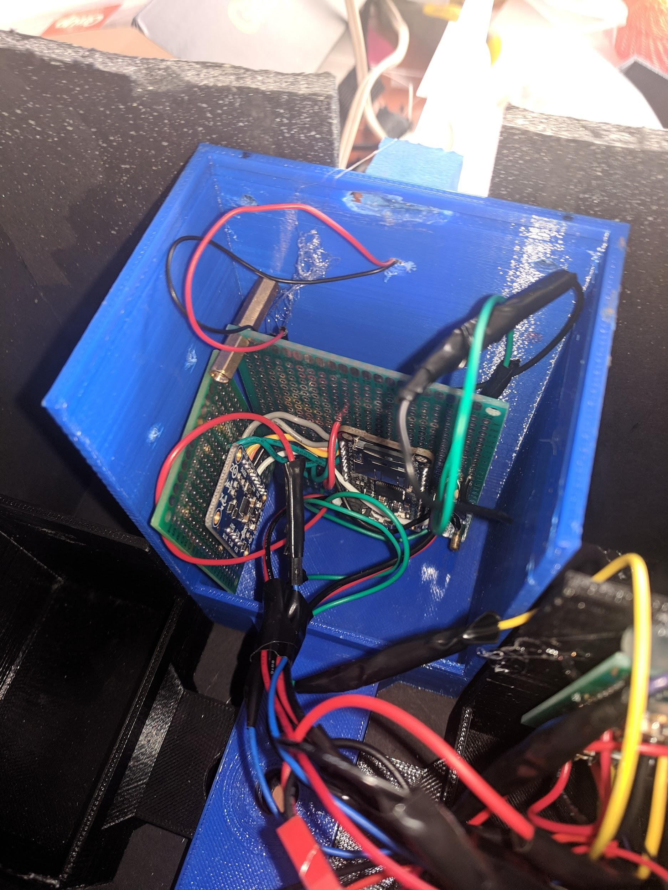
Fall Launch
Notes:
Investigations
Verification of electronics design for atmospheric data collection
Preliminary data future radiation shielding experiments
New videography method
Failure
Wiring
Housing design poor for wire management, led to damage
Success with APRS module, location data followed closely with the ANSR transponder

Slide 4
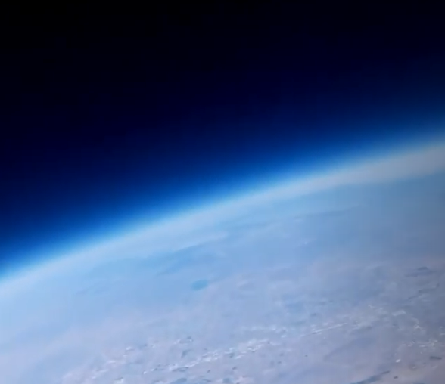
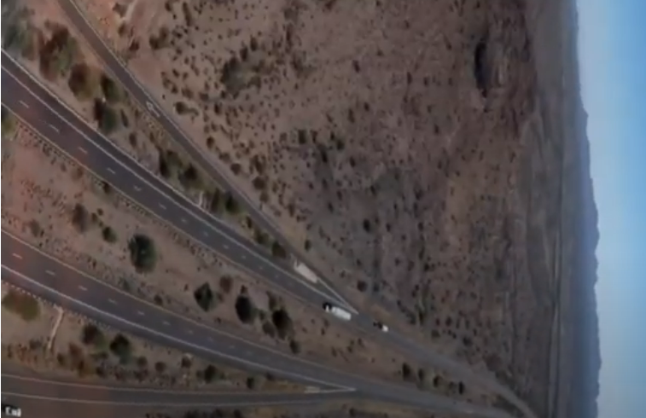
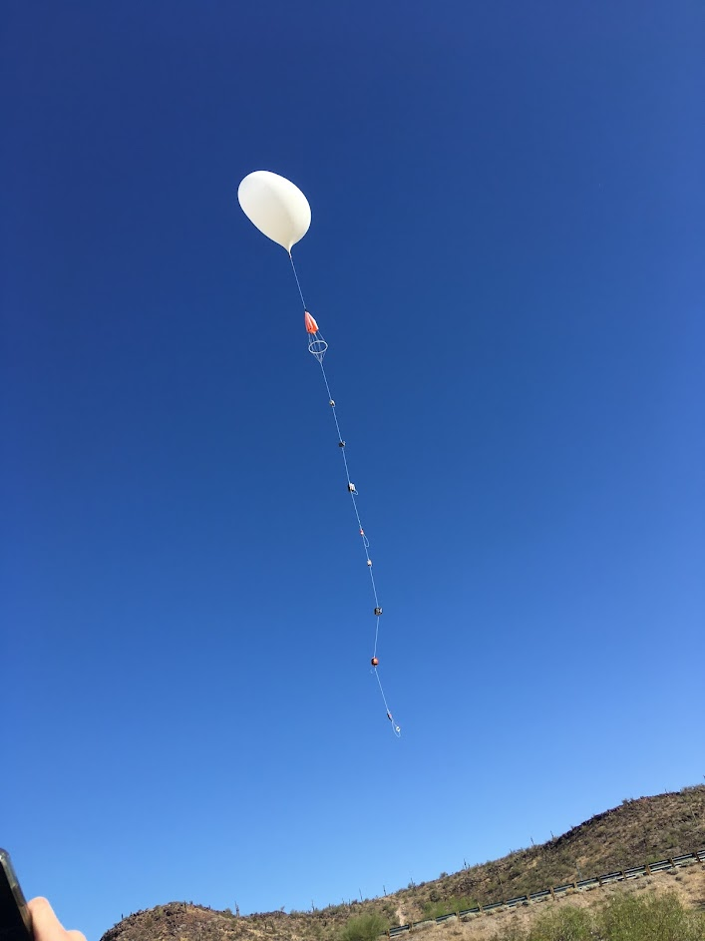
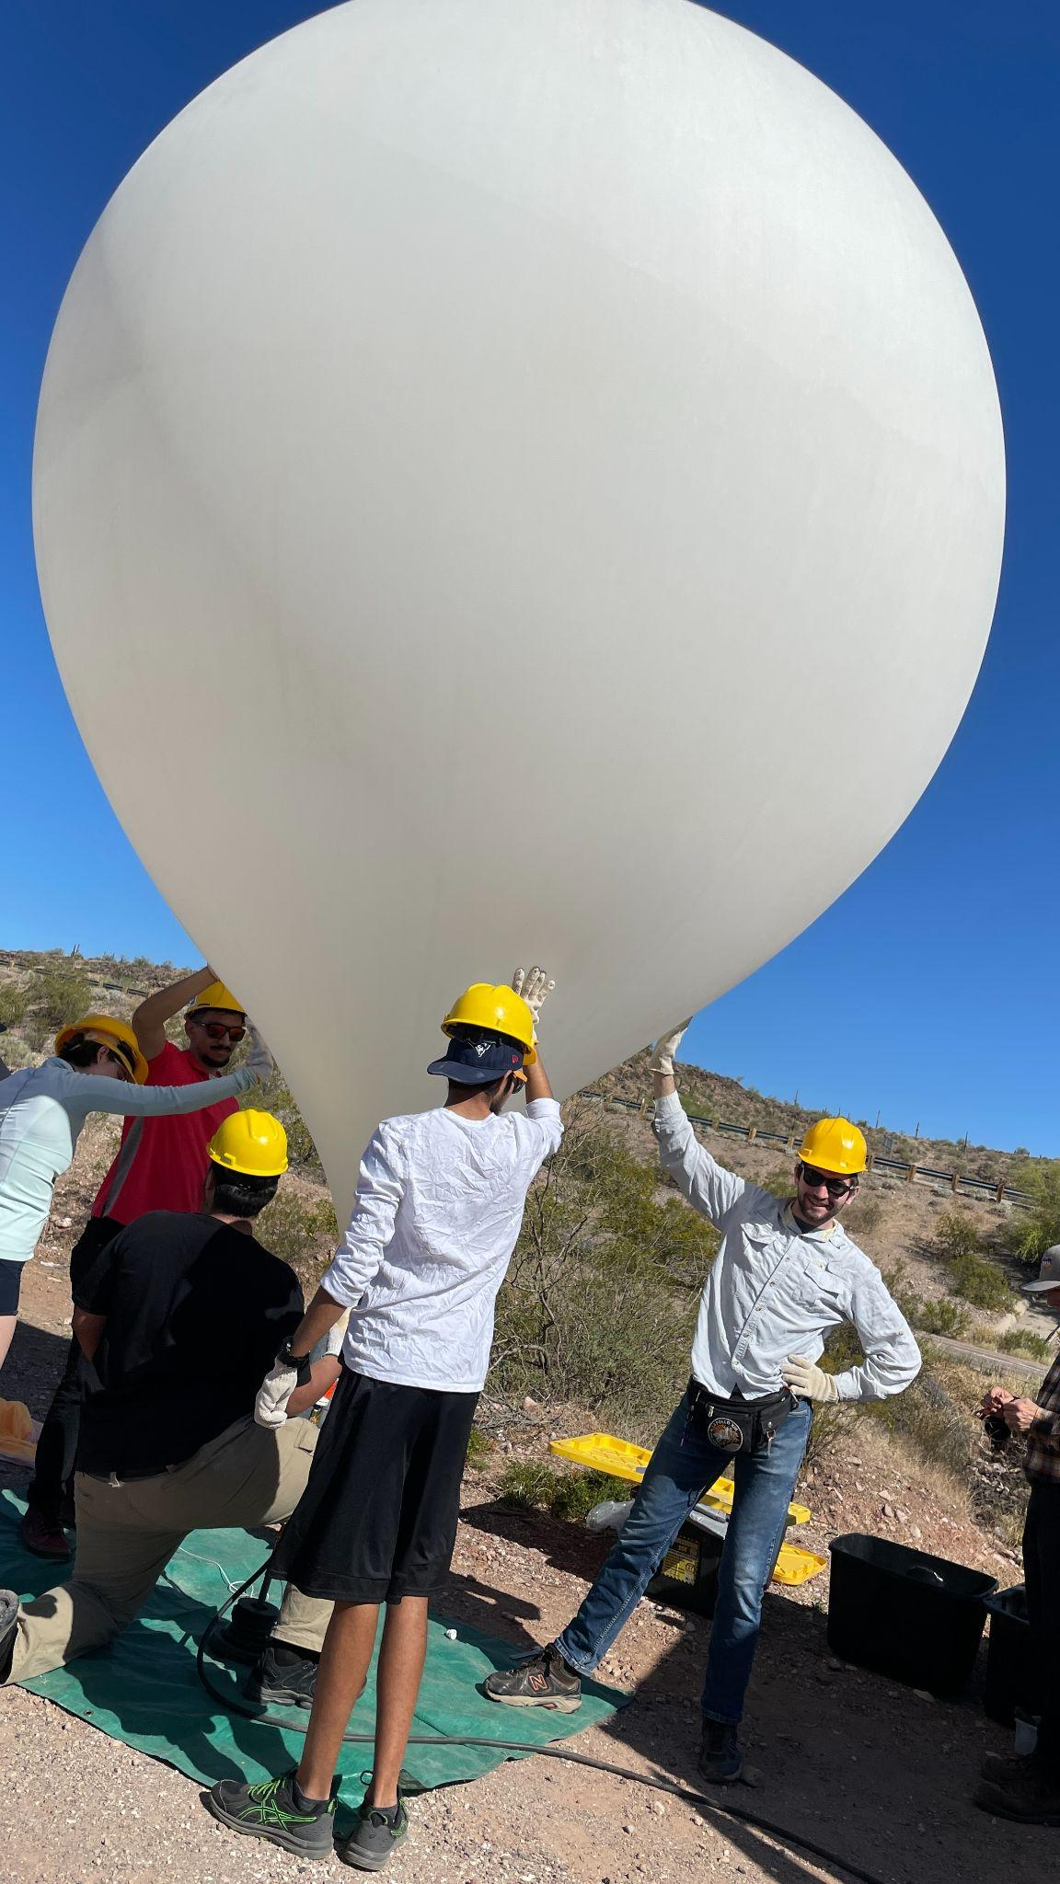
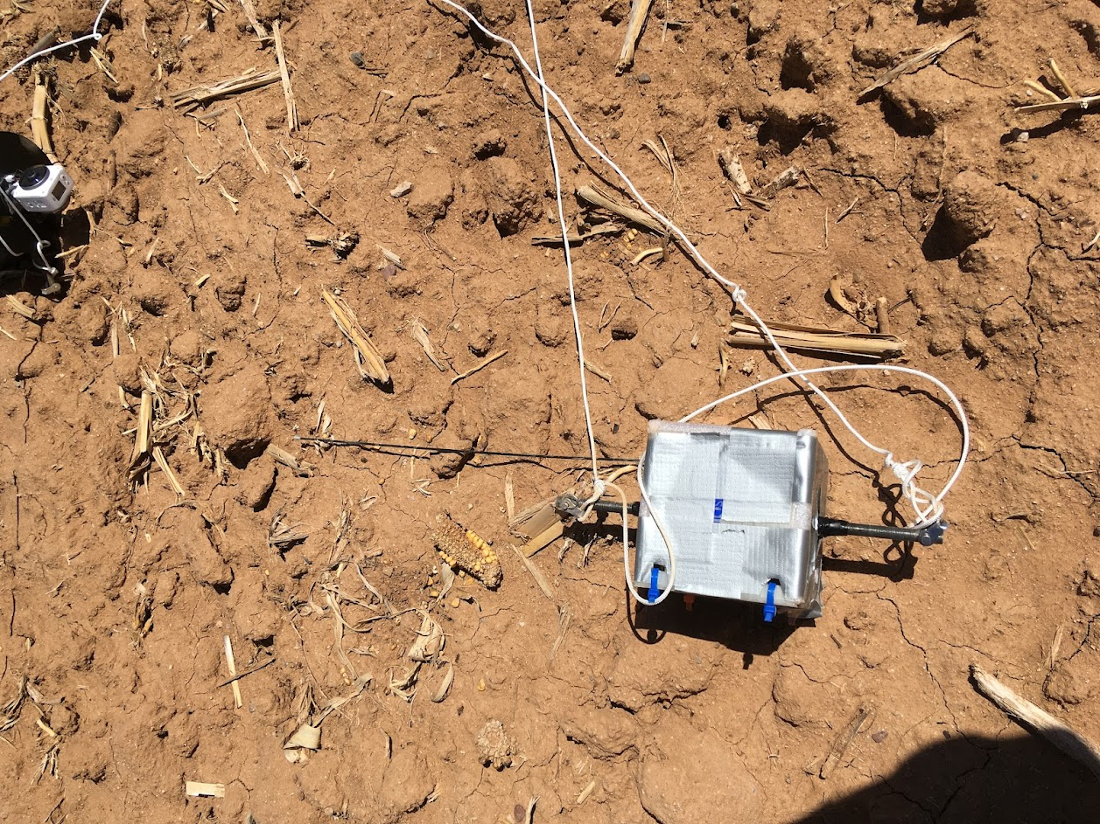
Spring Launch
Notes:
Investigations
Again...verification of electronics design for atmospheric data collection
Preliminary data future radiation shielding experiments (Fall data collection unsuccessful)
New housing design to fit all components inside
Successful launch — housing stayed intact, data collected and stored successfully

Slide 5
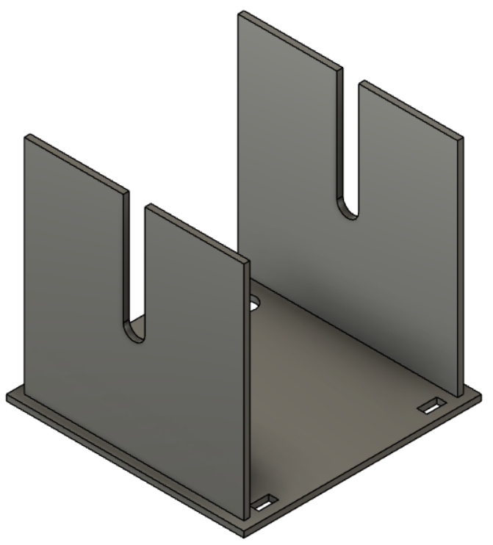
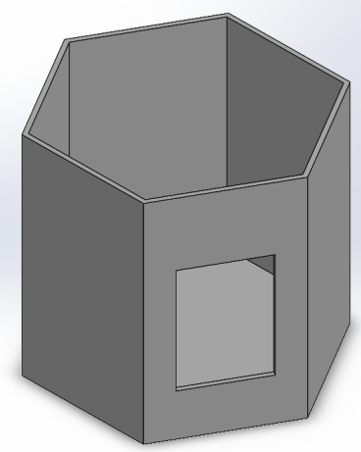
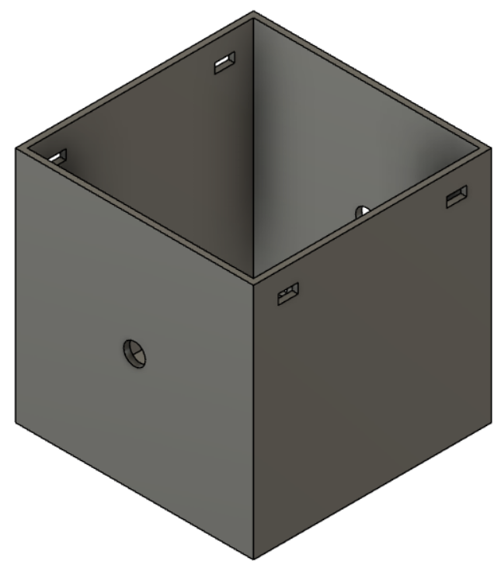
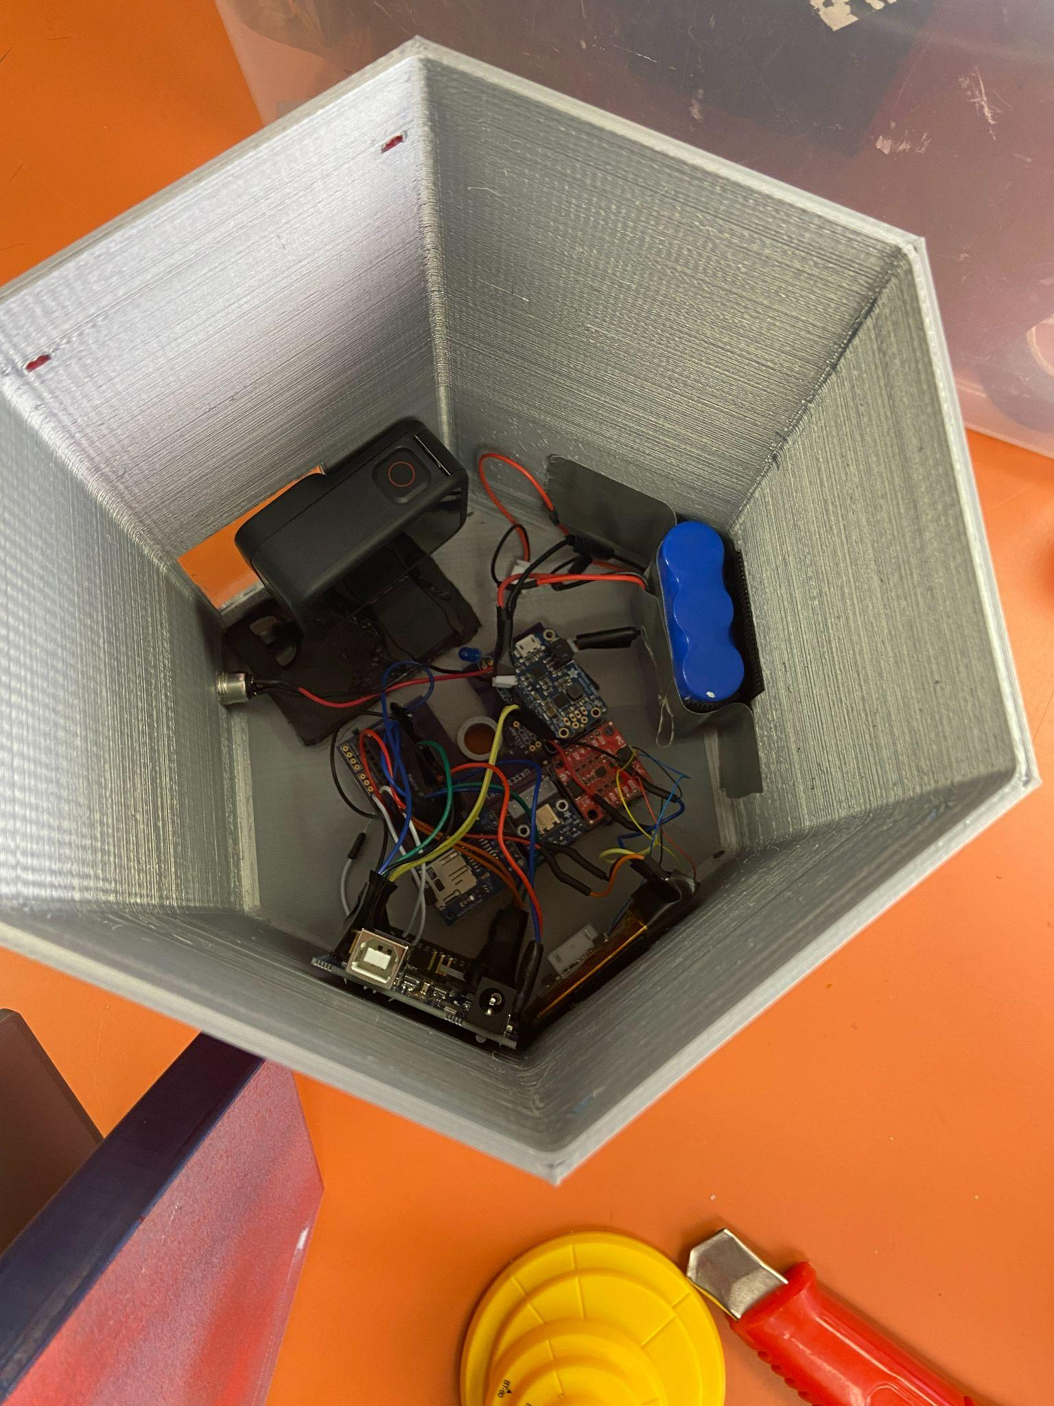
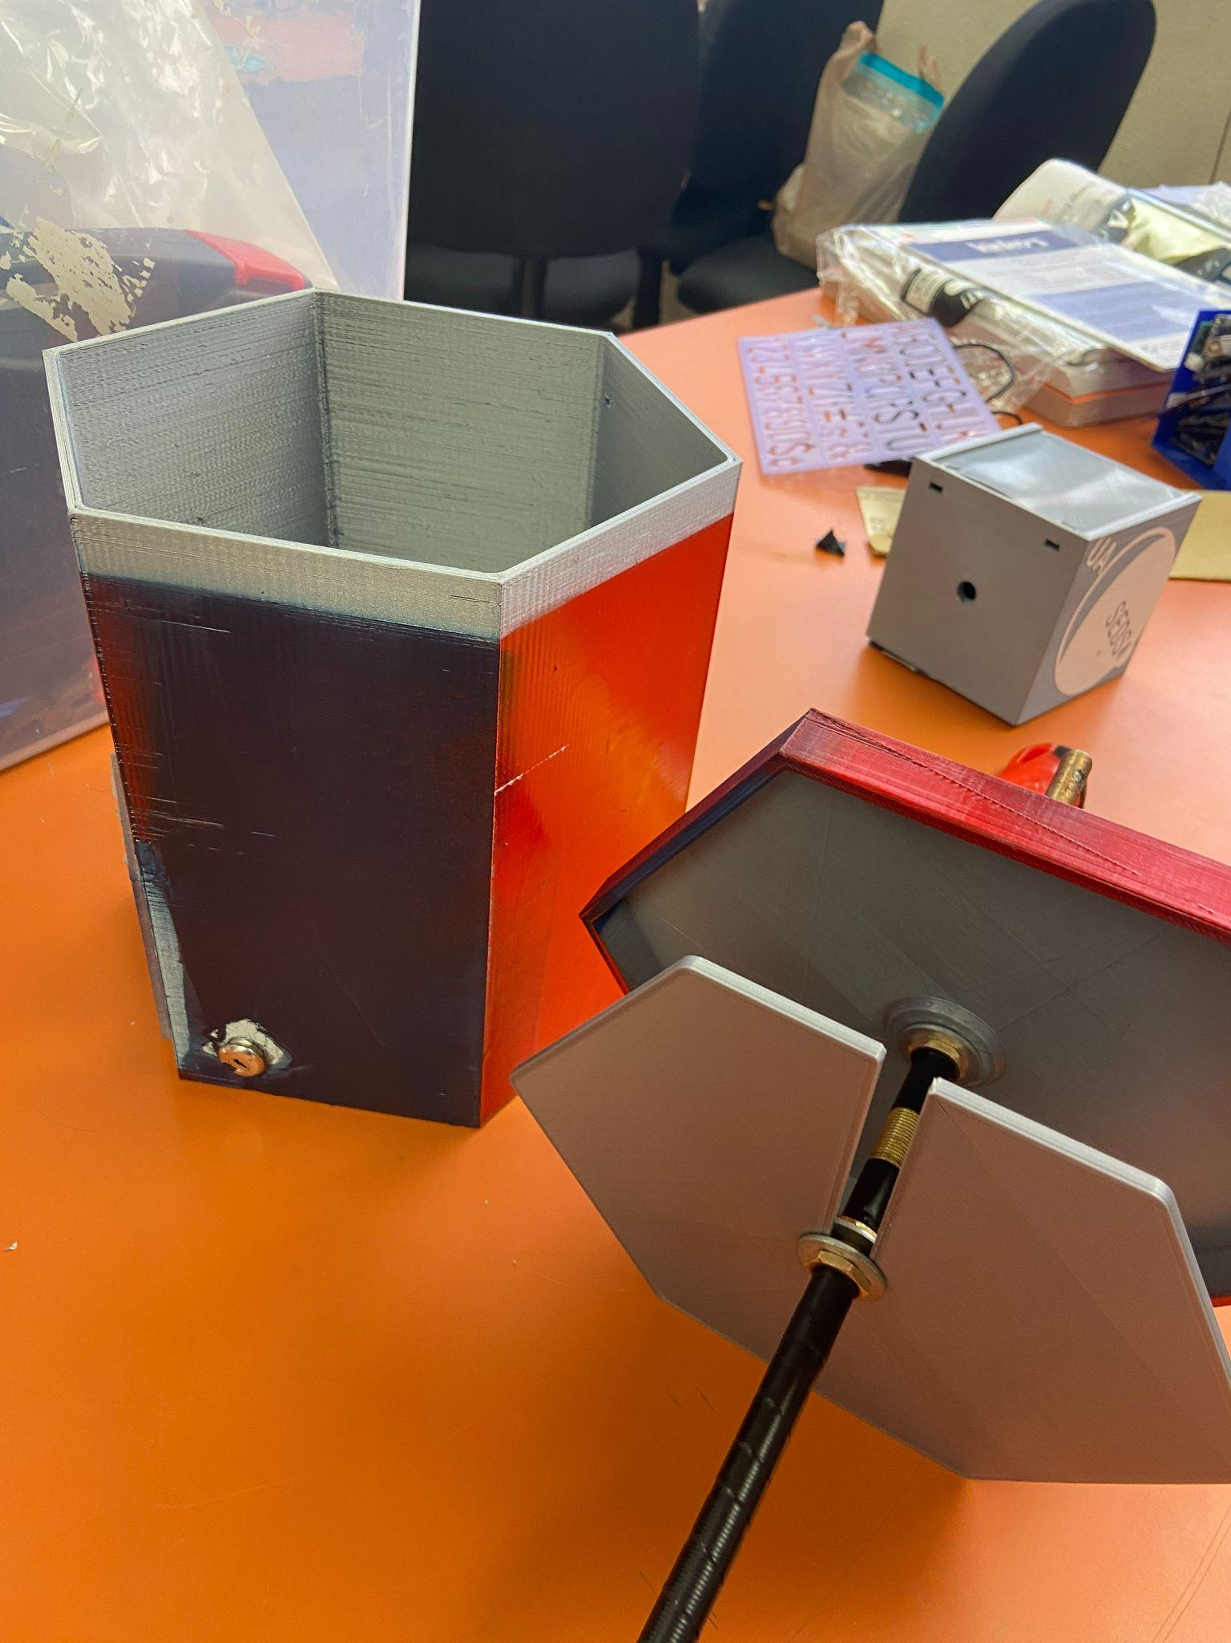
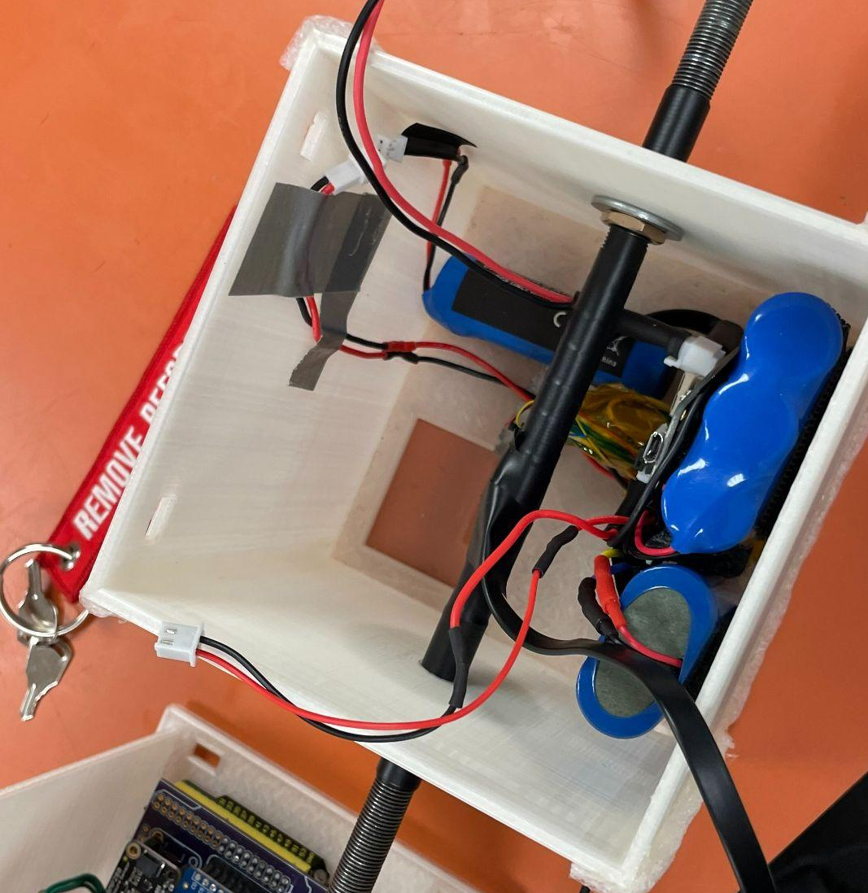
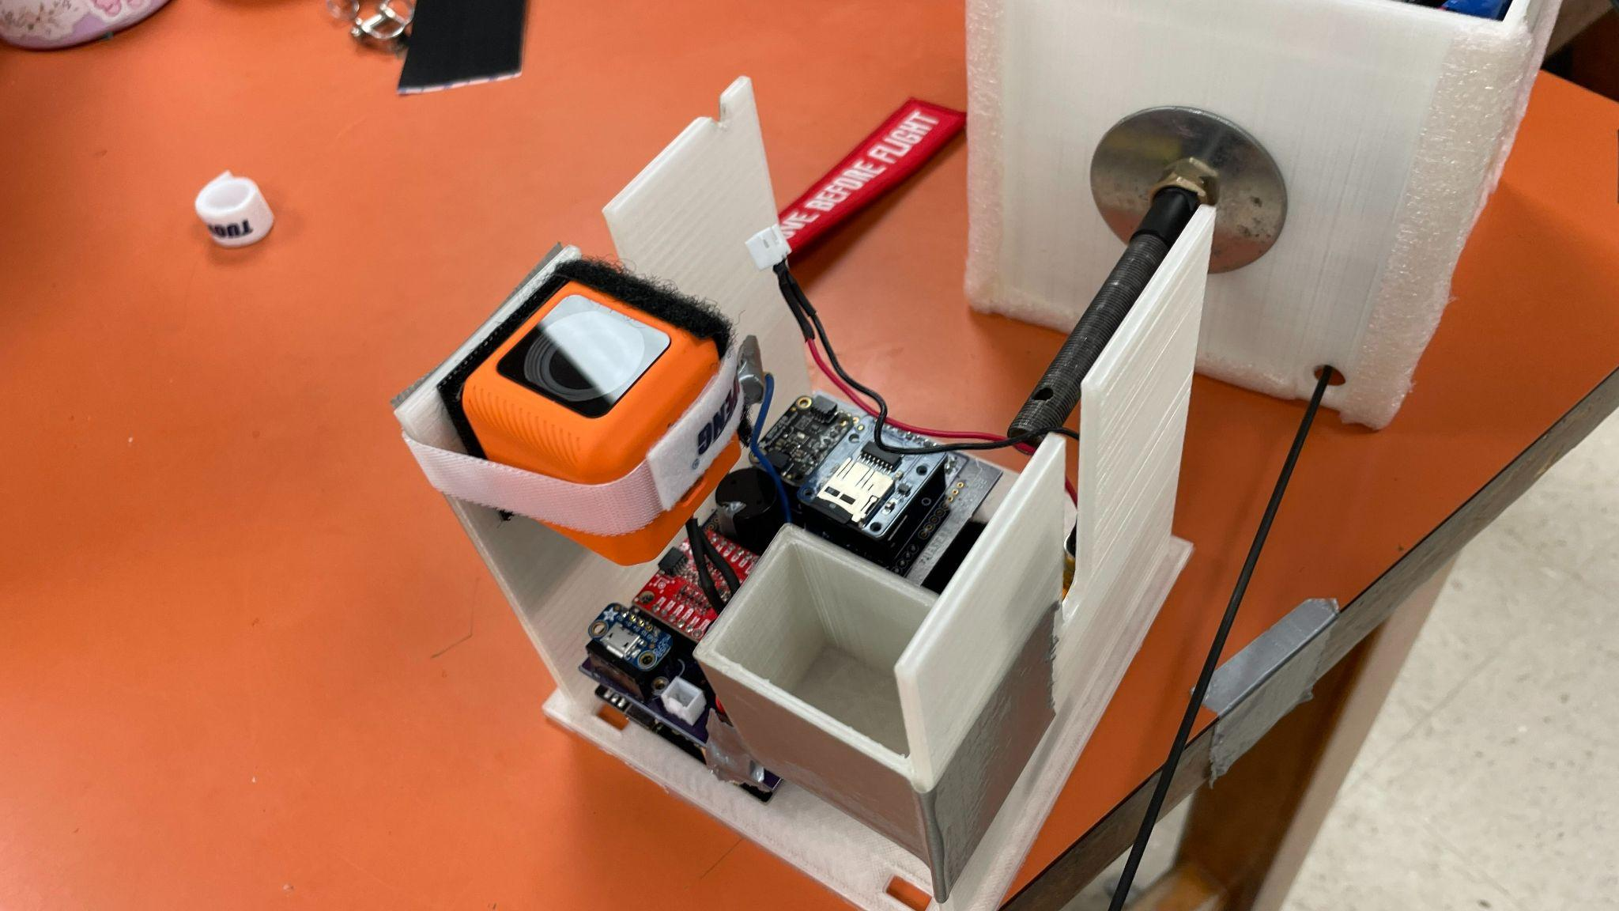
Housing Design
Fall Housing
3D Printed (PLA)
Hexagonal cylinder with side length 10.0 cm and height of 20 cm
Very heavy ~1.5 pounds empty
GoPro through polycarbonate window
Spring Housing
3D Printed (PLA)
Cubesat
(12x12x12cm)
Accessibility
Runcan through polycarbonate window
Printed from our school Library
Complete
Drawer
Design
Design
Complete
Notes:
Fall housing
Interior dedicated to electronics
Unable to use PCB designed in Spring since a part specified from Spring was no longer available in Fall
Required impromptu wiring which made failure far more likely
Drawer contained batteries and electronics
Temperature, pressure, humidity, radio components
Top-mounted geiger counters (2X)
Side mounted, exterior GoPro
“Time warp” mode in 4k resolution
Successful video capture (despite only ~45 minutes) and radio transmitter function
Spring housing
Interior desiccated to fit everything
PCB allowed for better fitment
1 3-cell LiPo, 1 2-cell LiPo
GoPro with polycarbonate window
Initially intending to run GoPro from main batteries
Voltage issue prevented camera from working properly
Decided to run at lower resolution and framerate to preserve battery life in retail GoPro battery
Since Fall failed with data collection, this presentation focuses on the Spring payload

Slide 6
Electronics (Fall Payload)
Component | Purpose
Mega2560 | Microcontroller
Adafruit BME 680 (I2C) | Atmospheric Profiler
9DOF IMU (I2C) | 3-Axis Accelerometer
RadiationWatch Pocket Geiger | Radiation Measurements
Adafruit MicroSD Card Module (SPI) | Datalogging
Adafruit Powerboost 1000c | Power Delivery / Voltage Regulation
6600 mAh LiPo | Power Storage
Status LED | Display System Status
Notes:
The heart of our payload was a central Adafruit Metro Mini, which served as our microcontroller.
We included two I2C sensors; an Adafruit BME 680 for atmospheric conditions (temperature, pressure, humidity, and gas constant) and an Adafruit MMA 8451 for acceleration data in 3 dimensions.
In addition to these two I2C sensors, we included one digital sensor; a RadiationWatch Pocket Geiger. The pocket geiger recorded Gamma radiation intensity by reporting radiation ticks to our microcontroller.
One of our main goals for the Spring launch was general datalogging, so to log all of the data from our sensors, we included an SPI MicroSD card module.
We chose to use this module because it gave us full control over what we are logging and how. Our unsuccessful Fall launch taught us that microcontroller/datalogger combos (such as the OpenLog Artemis) are too restrictive in what data you can log.
Lastly, our power delivery system was composed of two single cell Lithium Polymer batteries that stored around 11000 mAh of energy and powered everything onboard the payload.

Slide 7
Electronics (Spring Payload)
Component | Purpose
Mega2560 | Microcontroller
Adafruit BMP 280 (I2C) | Atmospheric Profiler
9DOF IMU (I2C) | 3-Axis Accelerometer
RadiationWatch Pocket Geiger | Radiation Measurements
Adafruit MicroSD Card Module (SPI) | Datalogging
Adafruit Powerboost 1000c x2 | Power Delivery / Voltage Regulation
13600 mAh LiPo | Power Storage
Status LED | Display System Status
APRS Transmitter | GPS data
Notes:
The heart of our payload was a central Adafruit Metro Mini, which served as our microcontroller.
We included two I2C sensors; an Adafruit BME 680 for atmospheric conditions (temperature, pressure, humidity, and gas constant) and an Adafruit MMA 8451 for acceleration data in 3 dimensions.
In addition to these two I2C sensors, we included one digital sensor; a RadiationWatch Pocket Geiger. The pocket geiger recorded Gamma radiation intensity by reporting radiation ticks to our microcontroller.
One of our main goals for the Spring launch was general datalogging, so to log all of the data from our sensors, we included an SPI MicroSD card module.
We chose to use this module because it gave us full control over what we are logging and how. Our unsuccessful Fall launch taught us that microcontroller/datalogger combos (such as the OpenLog Artemis) are too restrictive in what data you can log.
Lastly, our power delivery system was composed of two single cell Lithium Polymer batteries that stored around 11000 mAh of energy and powered everything onboard the payload.

Slide 8
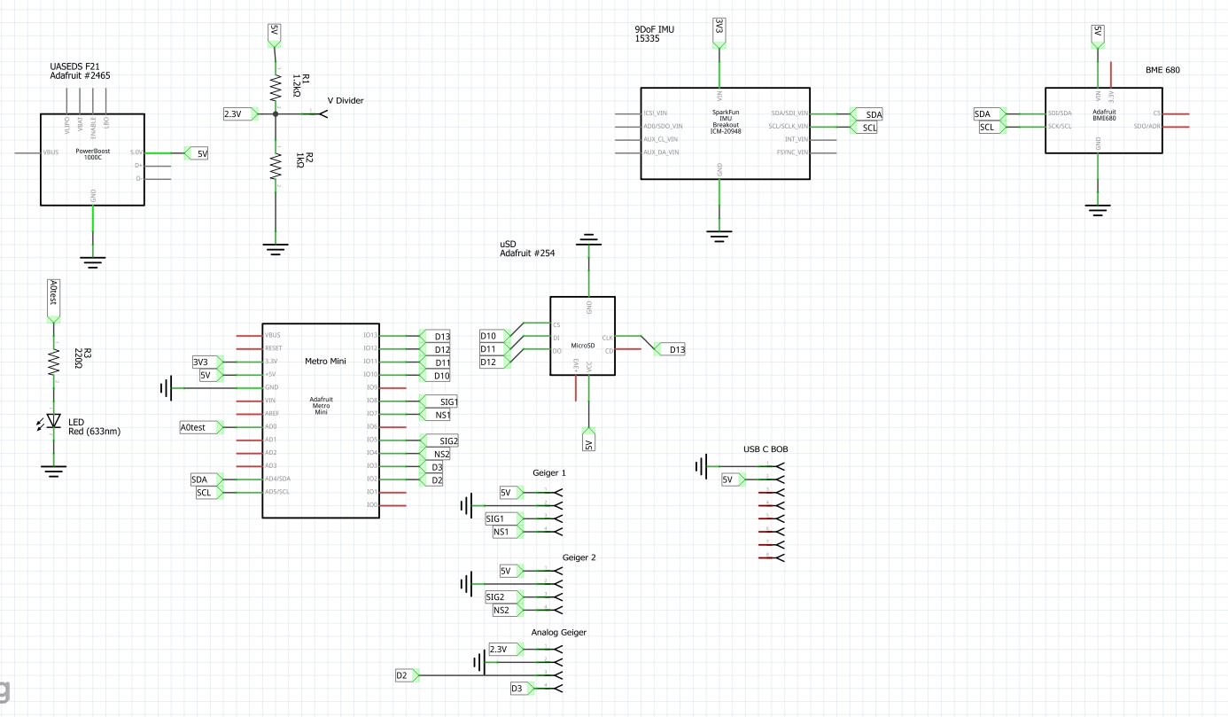
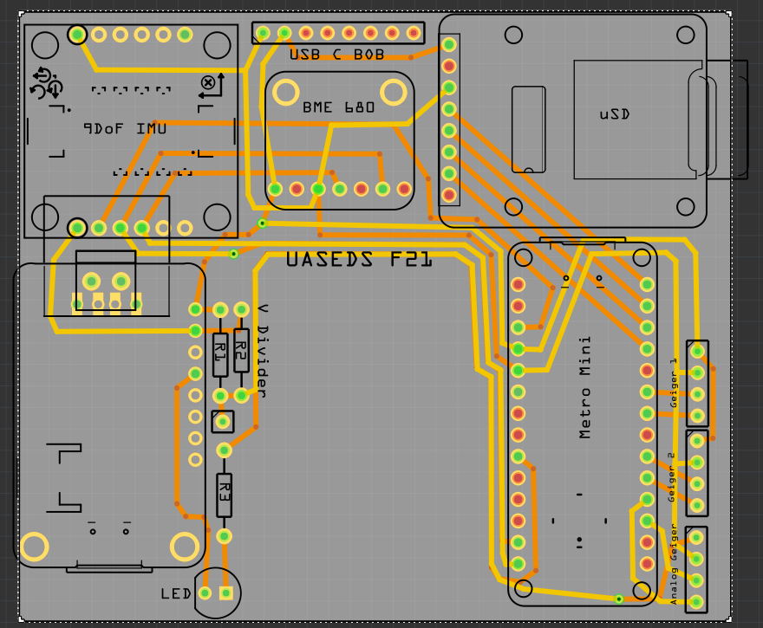
Schematic and PCB Fall 2021
Notes:
On the left is the circuit schematic for our electronic components, and on the right is the design for the printed circuit board based on the schematic.
We tried to keep our components as compact as possible on our PCB. Also, we chose to only populate one side of the PCB instead of both so that our PCB could lay flat against one side of our payload.
//Not pictured here is the Pocket Geiger, which is connected to GPIO pins 2 and 3 on the Metro Mini, and uses the 5v/gnd headers here. [points to open headers at bottom right corner]

Slide 9
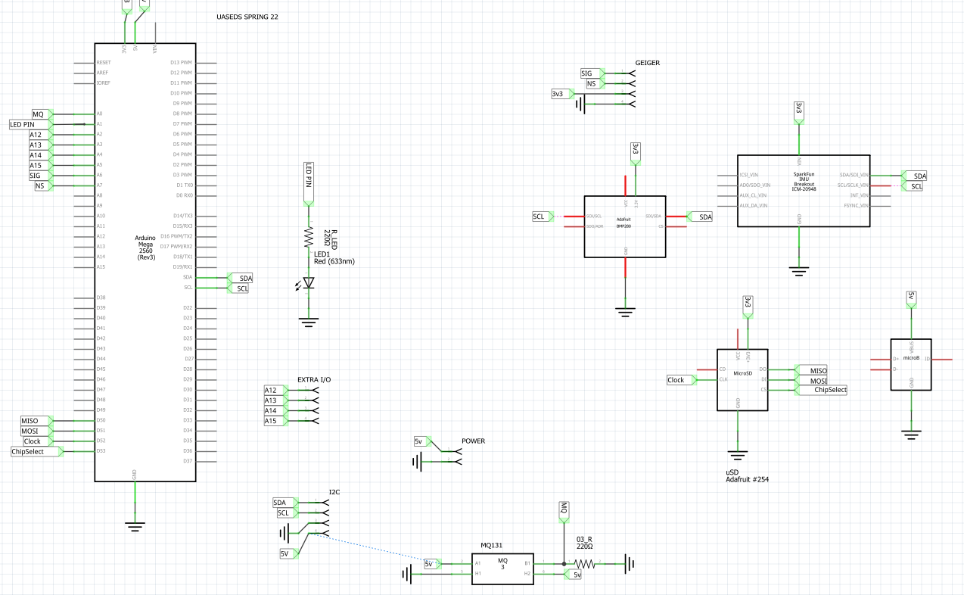
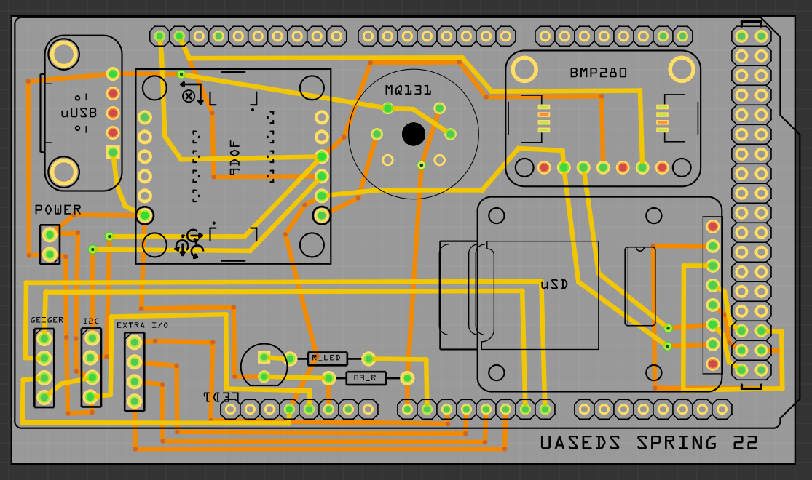
Schematic and PCB Spring 2022
Notes:
On the left is the circuit schematic for our electronic components, and on the right is the design for the printed circuit board based on the schematic.
We tried to keep our components as compact as possible on our PCB. Also, we chose to only populate one side of the PCB instead of both so that our PCB could lay flat against one side of our payload.
//Not pictured here is the Pocket Geiger, which is connected to GPIO pins 2 and 3 on the Metro Mini, and uses the 5v/gnd headers here. [points to open headers at bottom right corner]

Slide 10
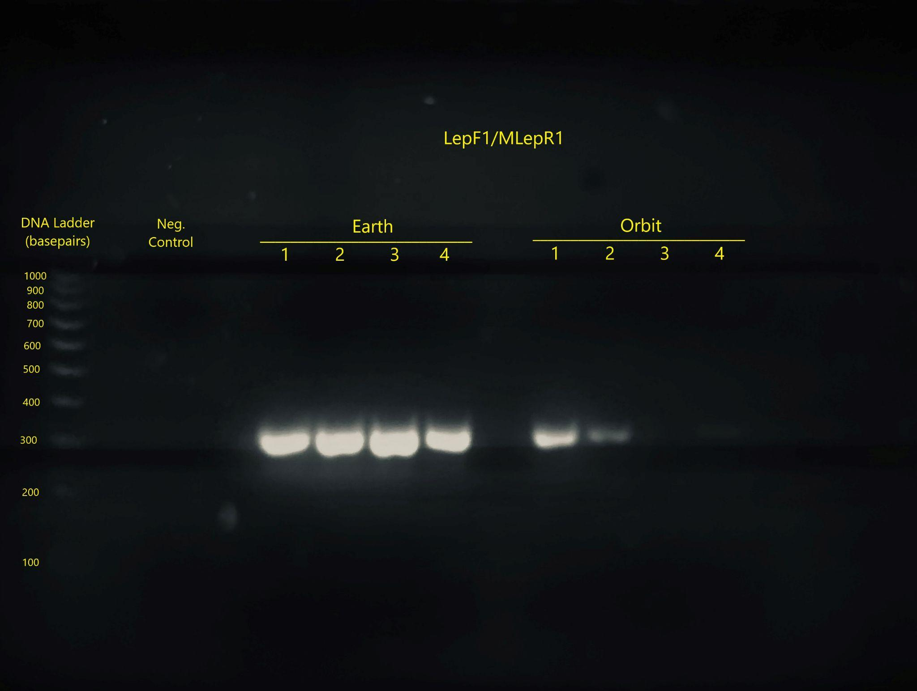
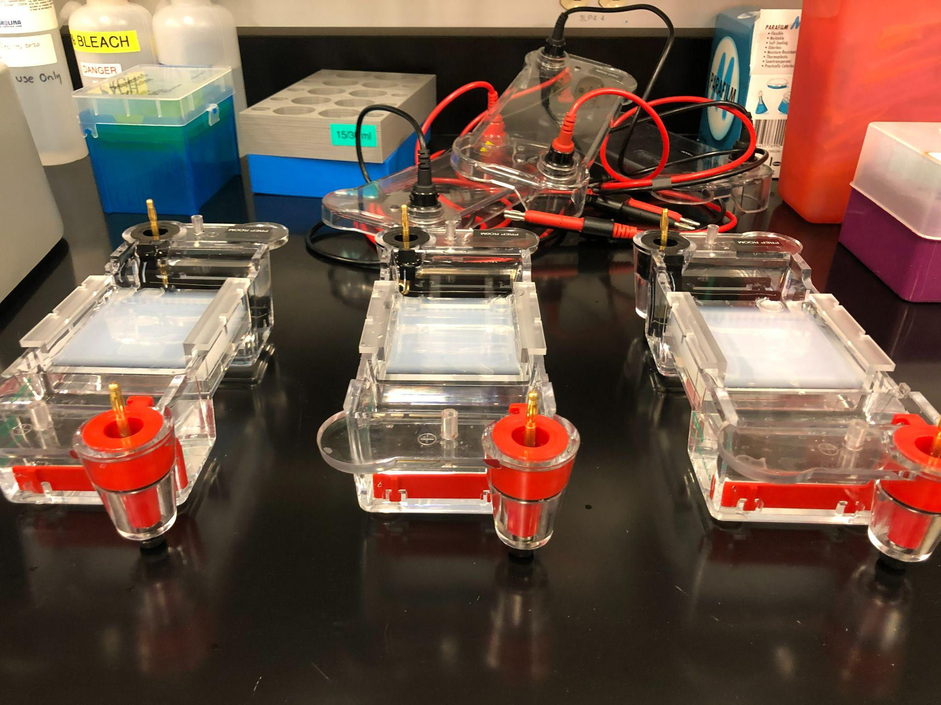
Biological Experiment

Slide 11
Spring Data + Conclusions

Slide 12
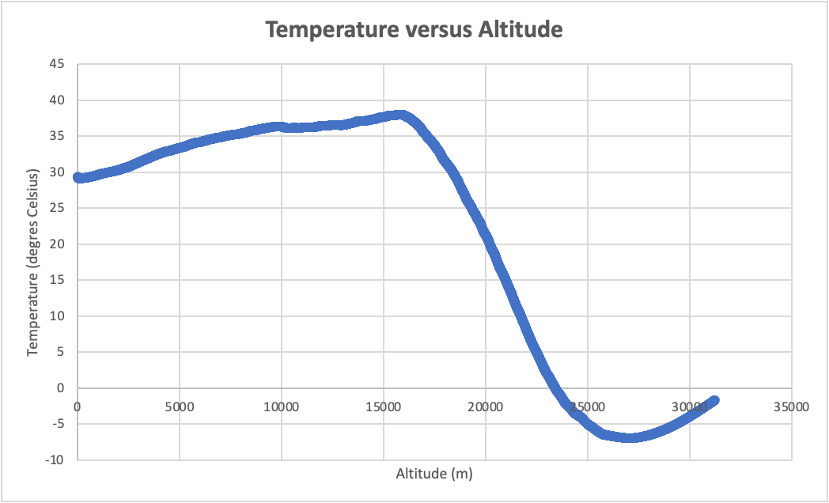
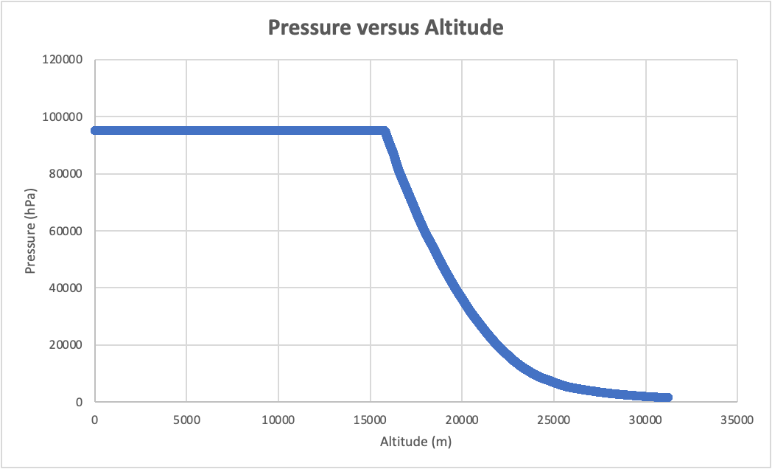
Temperature and Pressure

Slide 13
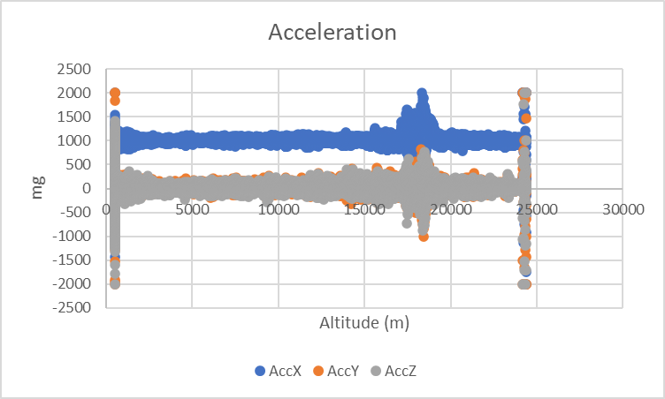
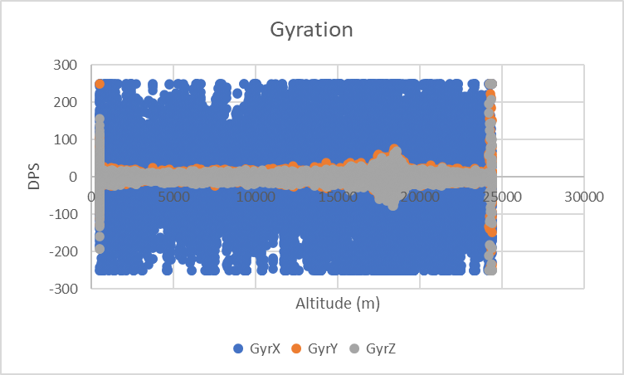
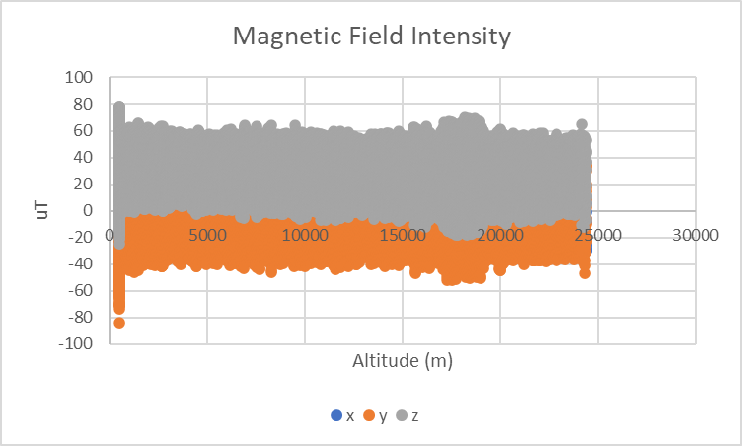
Accelerometer, Gyroscope, and Magnetometer

Slide 14
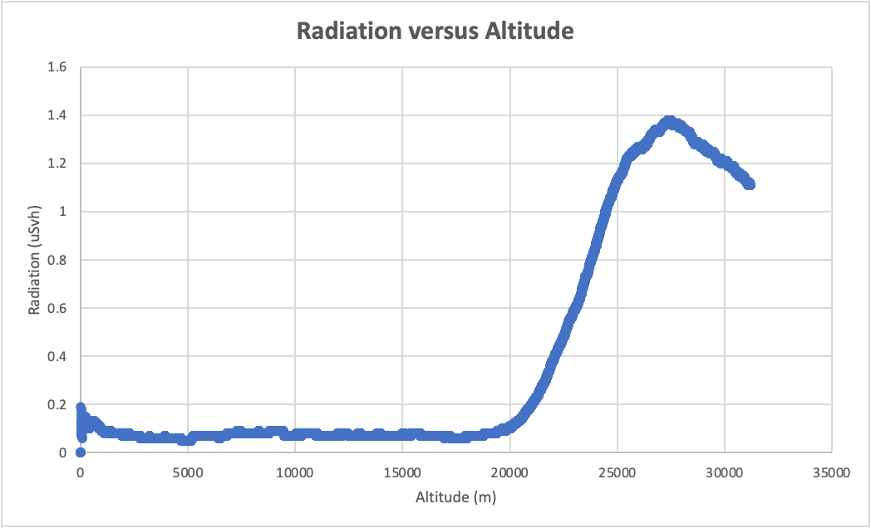
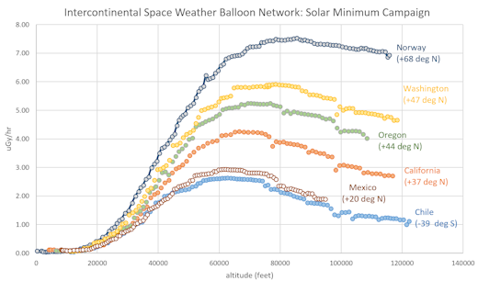
Dosimetry
https://spaceweatherarchive.com/2016/11/05/intercontinental-space-weather-balloon-network/

Slide 15
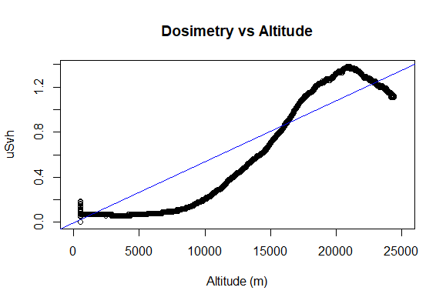
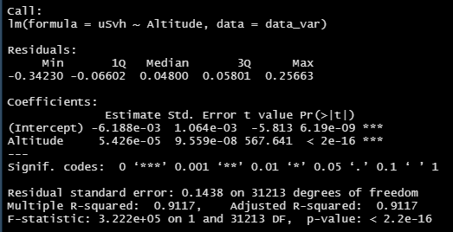

Slide 16
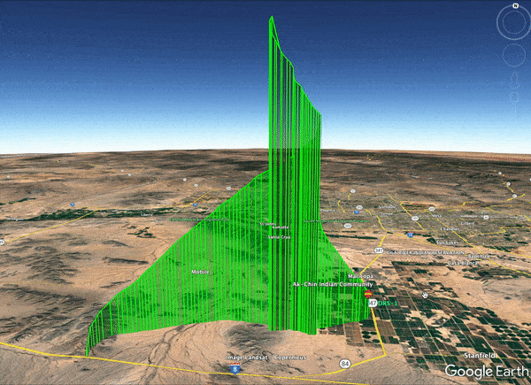
Trajectory

Slide 17

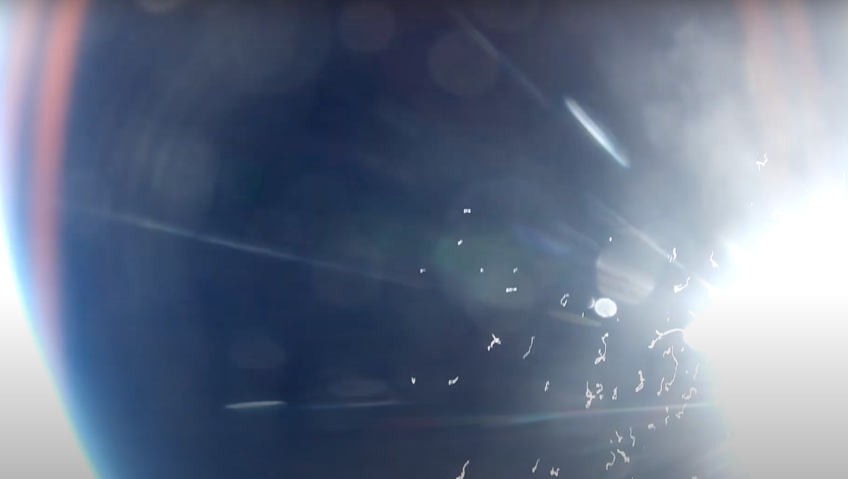
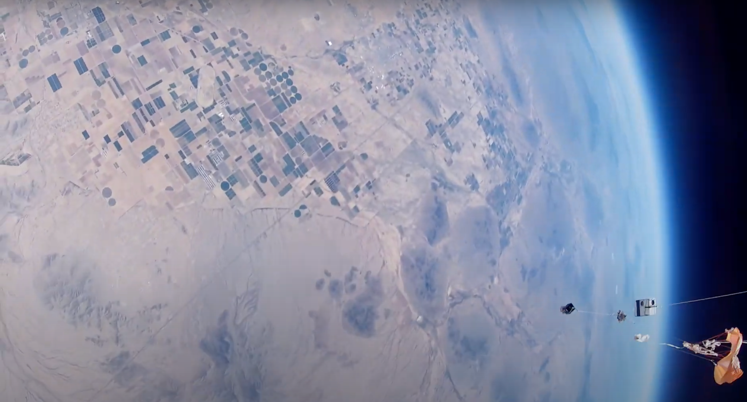
Spring Launch Balloon Pop

Slide 18
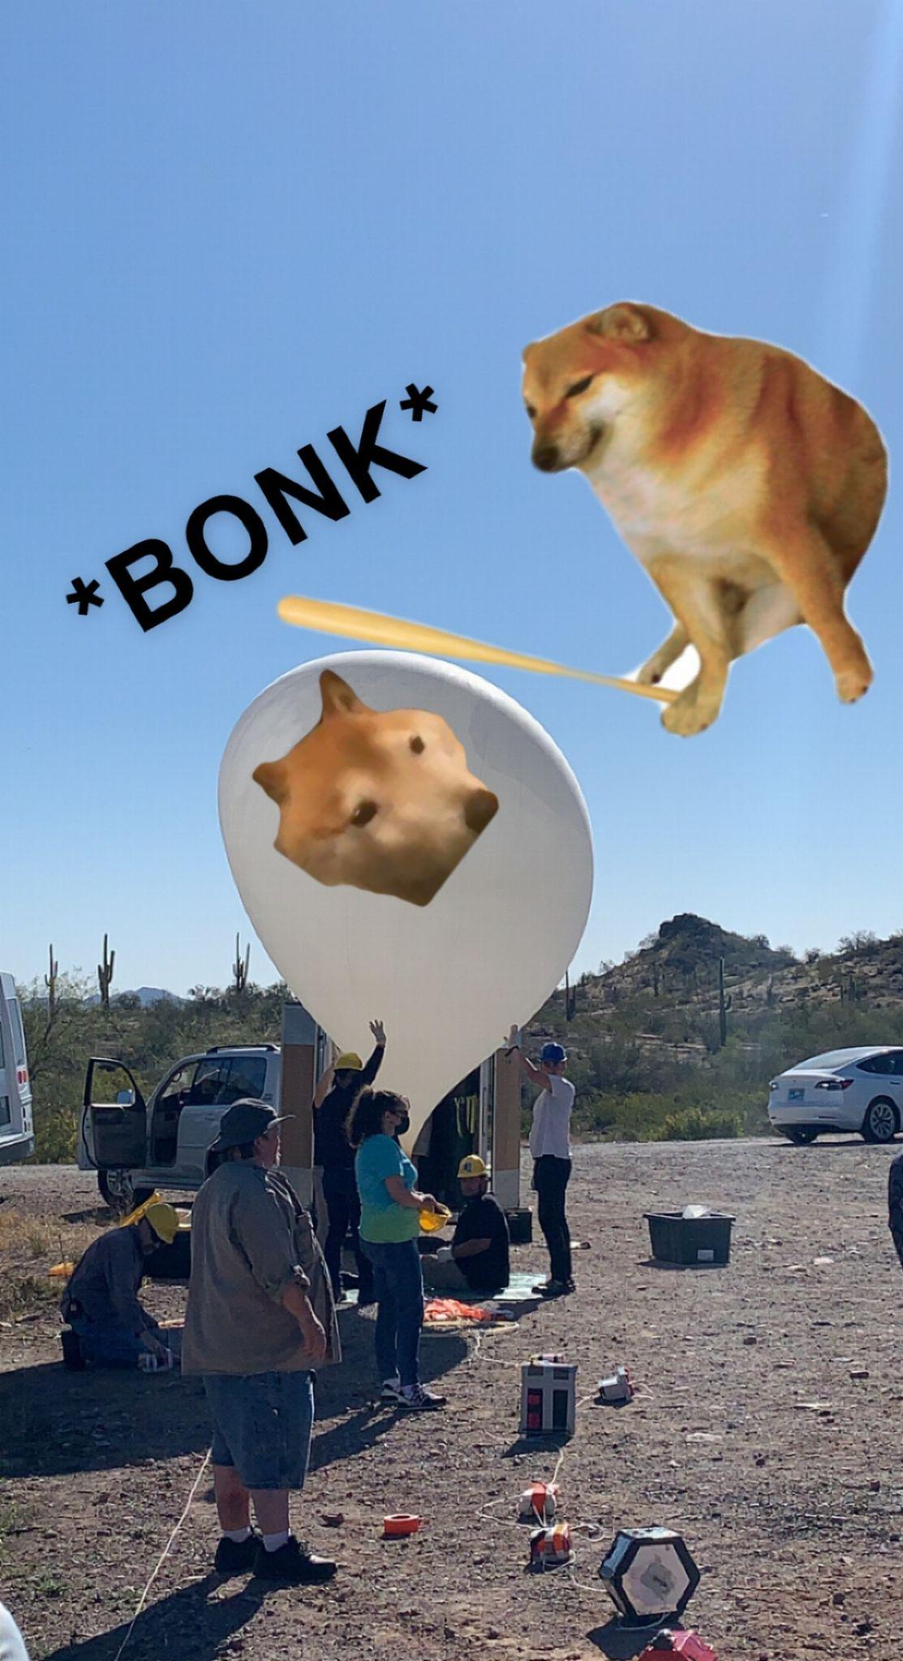
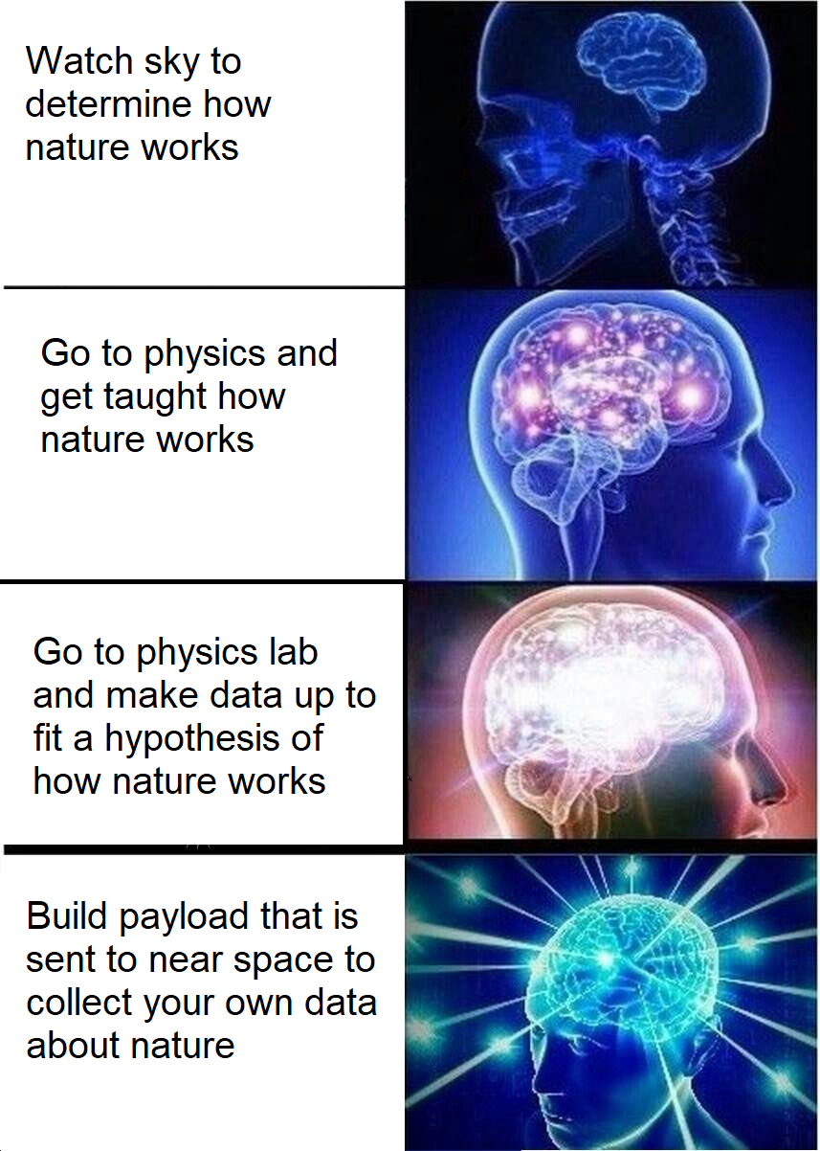
Memes

Slide 19


Thank You
Arizona Near Space Research
Arizona Space Grant Consortium
Michelle Coe
Radiation Reference: Dr. Tony Phillips, “Intercontinental Space Weather Balloon Network”
https://spaceweatherarchive.com/2016/11/05/intercontinental-space-weather-balloon-network/
arizonaseds@gmail.com
www.seds.arizona.edu

